Slide 1
Welcome To ANNAYA HOMES PVT LTD. Where Dreams Come Home

Slide 2
Home
Annaya Homes specialises in Designing and developing Premium Residential Townships.Tracing back to the sand of time in 2013 , the founders Annaya Homes started eventually expanding by setting up affordable houses in YAMUNA EXPRESSWAY. With an experience in creating resplendent interiors of palaces and masterpieces in YAMUNA EXPRESSWAY,Today , Annaya Homes, is one of the largest and only background integrated real estate players in the country .
Yamuna Expressway between Noida and Agra is 165 kms long and was built to reduce the traveling time between Delhi and Agra in Uttar Pradesh. This expressway has 6 lanes and will reduce the time of traveling between the two cities by 50%. Slow moving vehicles like push carts and bullock carts will not be allowed at the expressway. Light vehicles can travel at a speed of 100km/h whereas the heavy vehicles can travel at a speed of 60km/h at the expressway. The expressway other than reducing the time of traveling will help in the development and progress of the nearby areas. There is a continuous movement of traffic between Noida which is located in the vicinity of Delhi, the capital city and Agra, Delhi being the national capital city and Agra being the city of the famous Taj Mahal, are frequently visited by tourists. Noida itself is an emerging centre of trade in India. Yamuna expressway will help reduce traffic on National Highway 2 which earlier used to handle all the traffic directed towards Agra from Delhi and NCR (near capital regions including Noida) and areas like Faridabad and Palwal.

Slide 3
About Us
Annaya Homes Pvt. Ltd. is a leading Delhi NCR based company involved in real estate development, Construction, Colonizing work. Annaya Homes Pvt. Ltd. specializes in Designing and developing Premium Residential townships. Tracing back to the sand of time in 2013 , the founders Annaya Homes Pvt. Ltd. started eventually expanding by setting up affordable houses in Delhi NCR Region.
With an experience in creating resplendent interiors of palaces and masterpieces in Delhi NCR, Bihar & Jharkhand, Today, Annaya Homes Pvt. Ltd. , is one of the best and only background integrated real estate players in India.
Our main goal is to create a positive real estate experience while meeting clients needs. We specialize in the sale of single family and multifamily properties for investment or owner occupant purposes. If you are interested in selling your home, we will give your home all of the attention it needs to be promoted for the highest value possible in our marketplace. If you are interested in buying a home, we will do everything we can to give you the tools needed to help you find your dream home.

Slide 4
Our Mission, Vision, Values, Beliefs & Perspective
Mission
The Believe Group’s mission is to create and cultivate community. Our concept of community transcends selling real estate. We are connectors. We are contributors. We are tireless champions for our client community.
Vision
To be the real estate team of choice for buyers, sellers, Realtors, and highly talented professionals who value relationships over transactions, superior work, and community impact.

Slide 5
Values
Honesty
Quality
Learning-Based
Professionalism
Intelligence
Growth
Perspective
We seek to run a high performance real estate team that benefits our clients, our community, and eventually the world as a whole. We value family, spirituality, and giving back to those in need; we have designed our lives and business around this philosophy

Slide 6
Beliefs
Ethics. Do the right thing – always.
Quality matters most. Quantity will always be sacrificed in order to provide quality service at the highest level.
Growth Mind-set. There is always room to grow and refine. We never stop growing and learning.
First class service. Our clients deserve the best. We deliver the type of service that will make our clients swoon – professionally, ahead of promised timelines, and with a smile!
Relationships are the core of good business. We view each transaction as an opportunity to build a life-long relationship.
Efficiency. We will always find the way to do the most we possibly can for our clients – leveraging technology, new ideas, and support staff – so that your real estate transaction will be as easy and smooth as humanly possible.

Slide 7
Project
Annaya Homes Pvt. Ltd. Presenting “Annaya Homes” where idyllic, luxurious living meets 21st century amenities. Annaya Homes Pvt. Ltd. brings you the opportunity to build your home, your way on sprawling plots. Spread over 160 acres of land with additional expansion of luxury farm houses & villas over 25 acres. A gated community with 24x7 security and maintenance services, living at “Annaya Homes” ensures that you compromise neither on luxury nor on your peace of mind.
Combining the best of old-world charm with new-age facilities, the township will bring together a like-minded stratum of the society. A great neighborhood, easy accessibility, opens spaces, round-the-clock maintenance and the freedom to build your dream-house – '“Annaya Homes” is indeed what dreams are made of. Enjoy the privilege of a well –planned, self- contained township with ‘Annaya Homes’. It will not only offer a multiple choice of residential options but will also offer the facilities of academic institutions, healthcare, club house, shopping cum office entertainment facilities- all within the townships. It provides you with every amenity that you can imagine at a very affordable price..
We have Members from all India PSU organization. In Annaya Homes there are a Total approx 250 Plots further divided into Five Categories:-
60 Sq. Yard
80 Sq. Yard
100 Sq. Yard
150 Sq. Yard
200 Sq. Yard

Slide 8
Facilities
1. Gated Township
2. 3 Tier Security with Video Surveillance
3. Yoga and Meditation Area
4. Kids Play Area
5. Gardens
6. Solar Street Lights
7. Wide Road
8. Fragrance Zone
9. Rock Garden
10. Commercial Market
11. International Shopping Kiosk

Slide 9
USPs on YAMUNA EXPRESS WAY
1. Buddha International Circuit (F-1 Race Track) 2. Gautam Buddha University 3. India’s Largest JP Cricket Stadium (1 Lack Sitting Capacity) 4. Film City Jewar. 5. Night Safari (World 4th Night Safari) 6. YEIDA Plots (22500 plots on YAMUNA EXPRESSWAY) 7. SEZ India’s Largest Non polluted Industrial Area (Closest to this site) 8. Cargo Airport 9. Jewar International Airport/Noida International Airport .(Approx 4-6 K.M. from site ) 10. Total 7 Universities along YAMUNA EXPRESSWAY. 11. More than 20 colleges on YAMUNA EXPRESSWAY 12. 13 Hotel projects on YAMUNA EXPRESSWAY 13. P.A.C camp (Under construction near Aligarh Palwal loop) 14. International freight corridor Center No. 7, DMIC center near Jewar 15. Jewar Junction (In next 2 years)(Approx 2-3 K.M. from Site)
16. NTPC Power Plant for electricity Production in Khurja (Approx 30 K.M. from Site)
17. IOCL Refinery (Approx 80 K.M. from Site)

Slide 10
Distance after FNG-KMP loop
Distance after FNG-KMP loop
* 70 Minutes Drive from Gurgaon * 30 Minutes Drive from Palwal * 50 Minutes Drive from Aligarh * 30 Minutes Drive from G. Noida * 50 Minutes Drive from Kalindi Kunj * 45 Minutes Drive from Noida * 60 Minutes Drive from Akshar Dham Temple * 70 Minutes Drive from Mathura

Slide 11
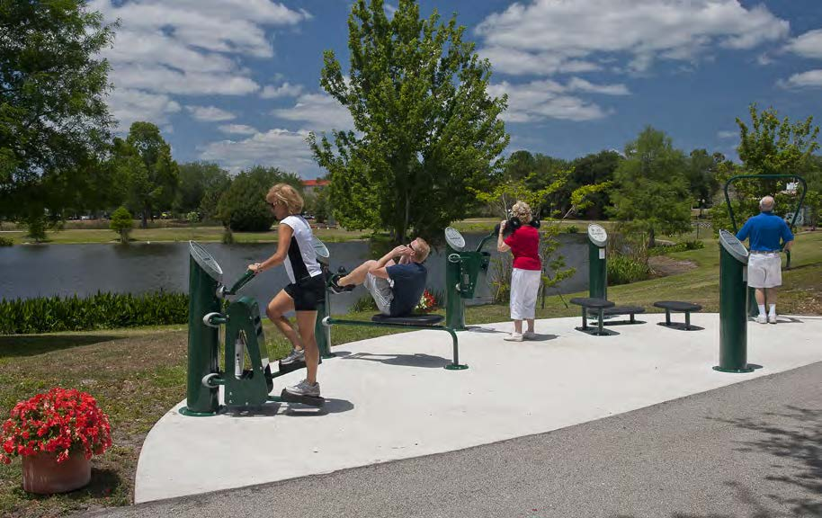
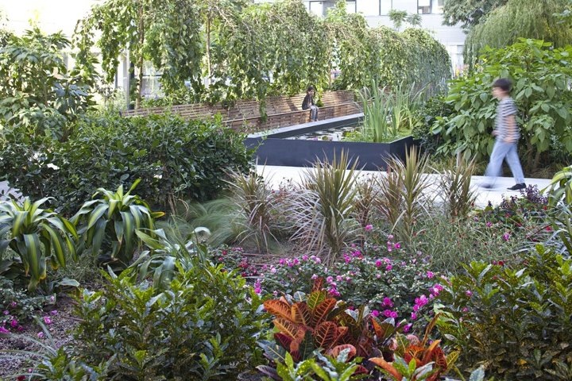
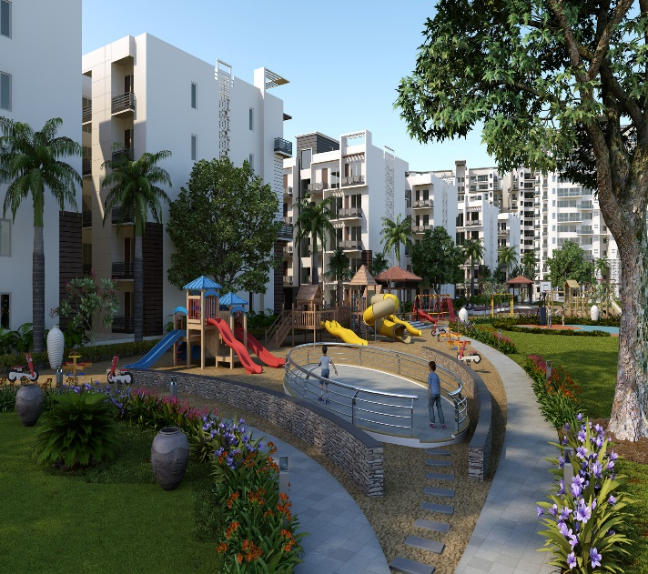
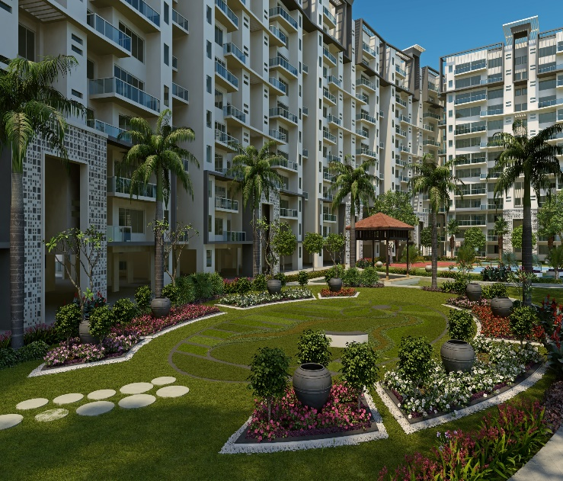
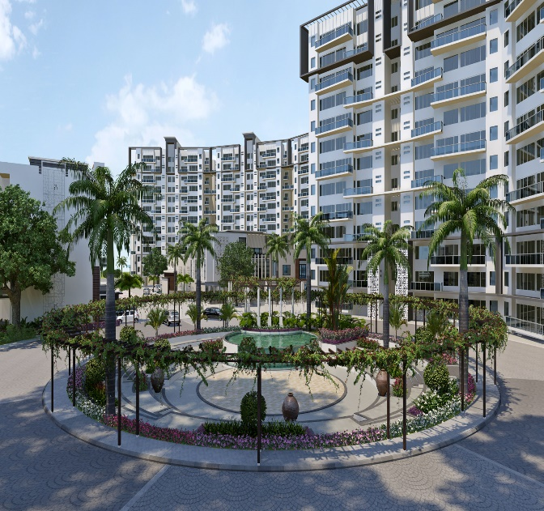
Amenities

Slide 12
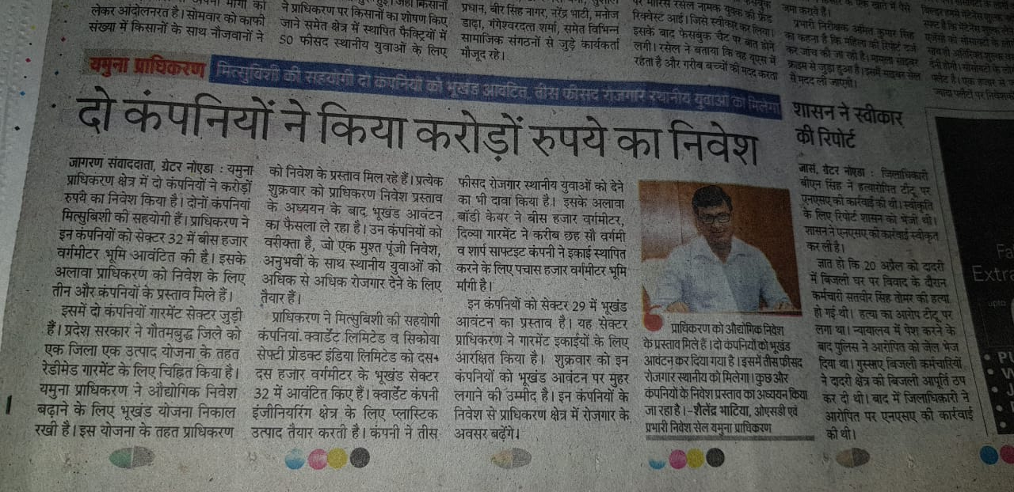
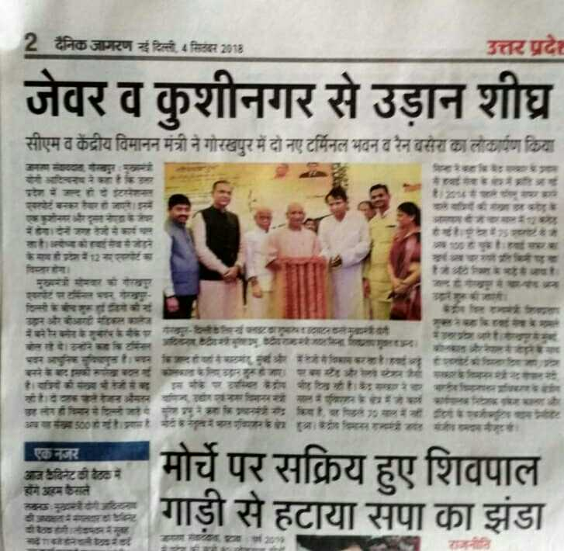
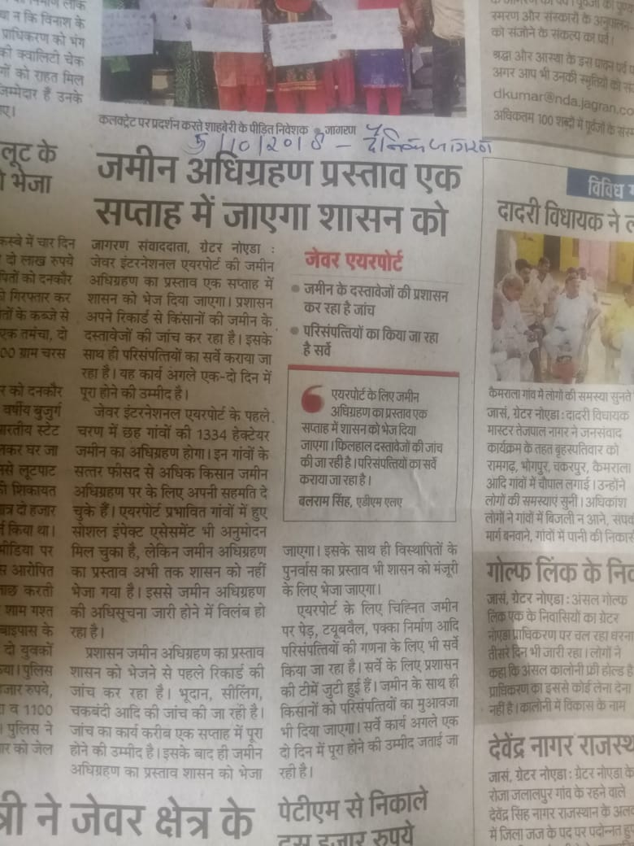
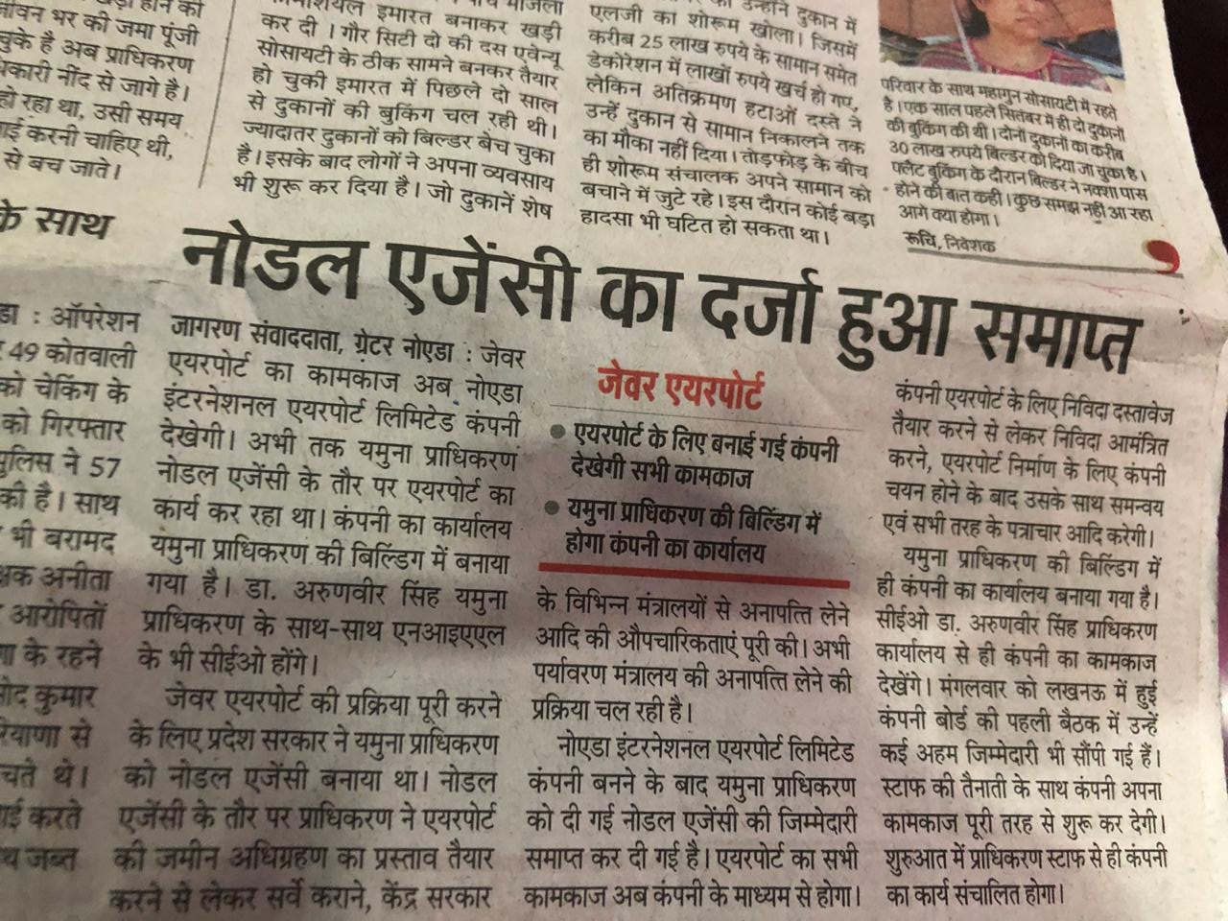
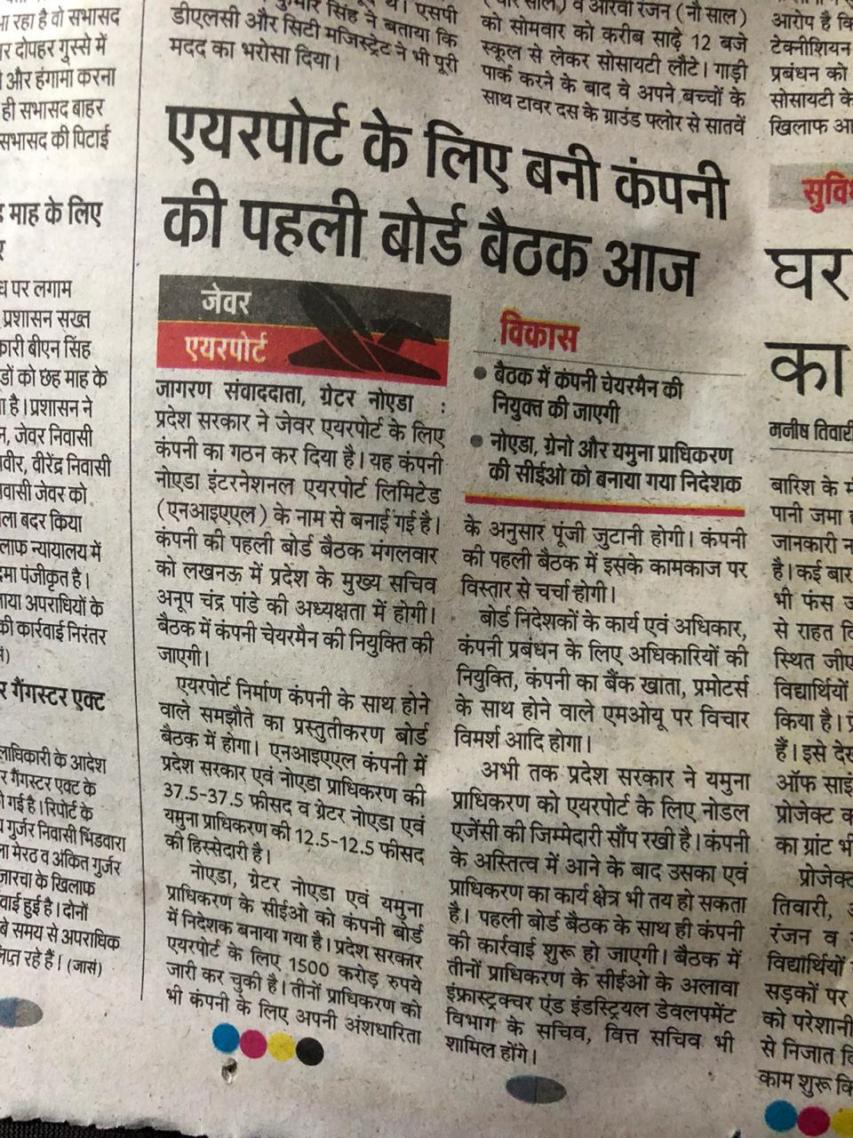
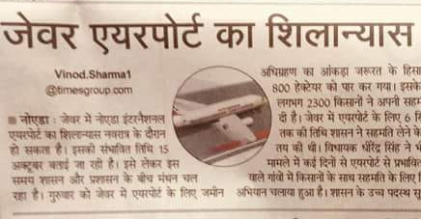
News

Slide 13
Layput Plan

Slide 14
Location Map

Slide 15
Payment Plan

Slide 16
Preferential Location Charge

Slide 17
THANKS & REGARDS
ANNAYA HOMES PVT. LTD
43, First Floor, Omaxe Arcade, Ansal Golf Link 1, Near Pari Chowk, Greater Noida,
Distt. Gautam Buddh Nagar, U.P. - 201308
Mob.: 9650743341, 9911144212
Email: annayahomes@gmail.com
Web: www.annayahomes.com

